Slide 1
Tri-Netra AI: Advanced Brain Tumor Detection
Anannya Vyas | Roll No. 9 CCET, Chandigarh Training: NIELIT Chandigarh

Slide 2
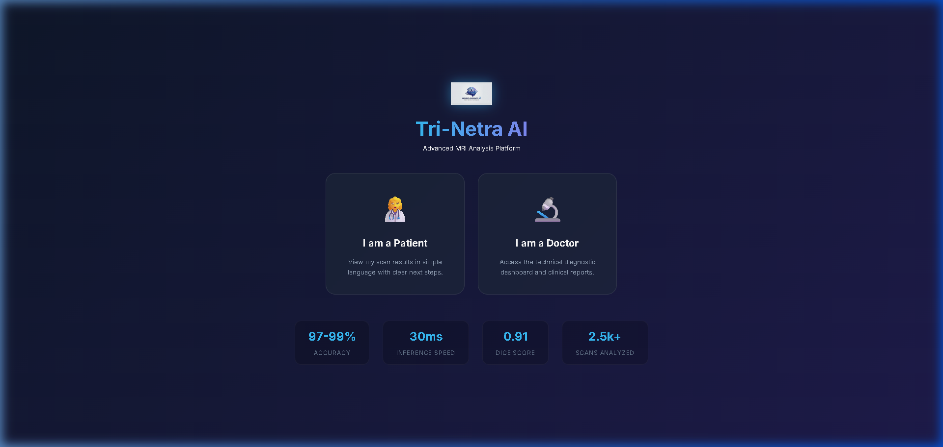
System Architecture

Slide 3
Results & Features
Models & Accuracy: • Custom CNN: 97.50% (Fast) • Transfer Learning (ResNet50): 98.25% • Vision Transformer (ViT): 98.00% (ROC AUC 0.9975) Key Innovations: • Zero Hallucination LLM Reporting • Ensemble rule verification • Conformal Prediction for 90% coverage guarantee

